Slide 1
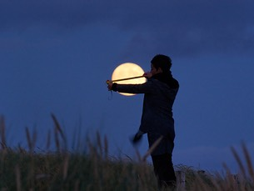
Angular Size

Slide 2
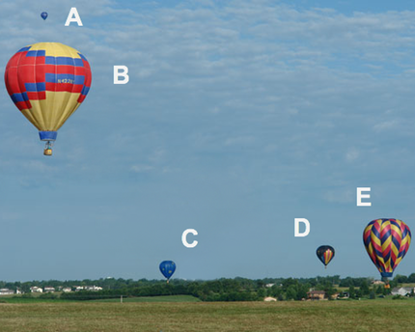
Assuming the balloons are the same size, which is closest to the observer?

Slide 3
Assuming the balloons are the same size, which is closest to the observer?
B
Appears largest
(largest angular size)

Slide 4
Assuming the balloons are the same size, which is farthest away?

Slide 5
Assuming the balloons are the same size, which is farthest away?
​
A
​
Appears smallest
(smallest angular size)​

Slide 6
Still assuming the balloons are the same size, where are B and E in relation to the observer and each other?
E is twice as close to the observer as B
B is about the same distance from the observer as E
B is twice as close to the observer as E
B is four times closer than E
B is eight times closer than E

Slide 7
Still assuming the balloons are the same size, where are B and E in relation to the observer and each other?
E is twice as close to the observer as B
B is about the same distance from the observer as E
B is twice as close to the observer as E
(B appears twice as tall)

Slide 8
Now suppose C is twice as big as D. If C is 2 miles away, how far is D?
1 mile
2 miles
4 miles
3.659 miles
Impossible to say

Slide 9
Now suppose C is twice as big as D. If C is 2 miles away, how far is D?
1 mile
(Same angular size
C is twice as big as D
thus C is twice as far as D)

Slide 10





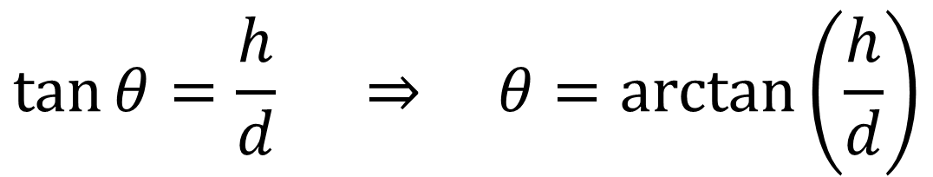


$$h$$
$$θ$$
$$d$$
$$\tan{θ}=\frac{h}{d} ⇒ θ=\arctan\left(\frac{h}{d}\right)$$

Slide 11




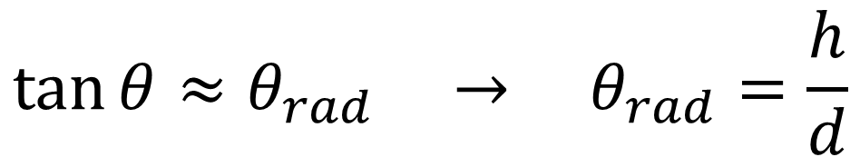
$$h$$
Small Angle Approximation
$$h≪d$$
$$θ$$
$$d$$
$$\tan{θ}≈θ_{rad} → θ_{rad}=\frac{h}{d}$$

Slide 12
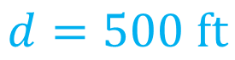
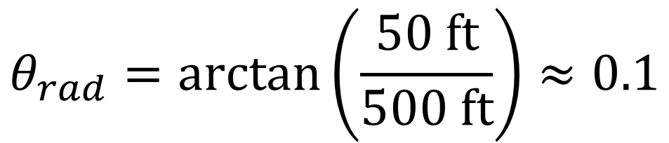
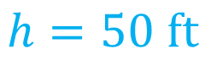
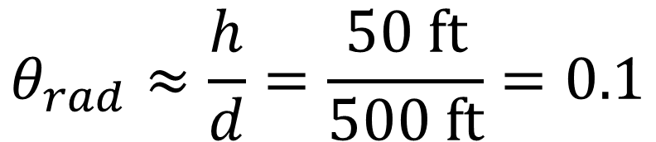
$$θ_{rad}=\arctan\left(\frac{50 ft}{500 ft}\right)≈0.1$$
$$θ_{rad}≈\frac{h}{d}=\frac{50 ft}{500 ft}=0.1$$
$$h=50 ft$$
$$θ$$
$$d=500 ft$$

Slide 13






$$θ_{rad}=\frac{h}{d}=\frac{y}{1 meter} ⇒ θ_{rad}=y[meters]$$
$$h$$
$$θ$$
$$y$$
$$1 meter$$
$$d$$

Slide 14
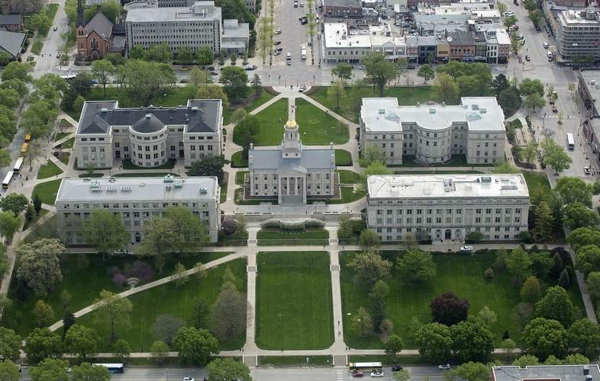
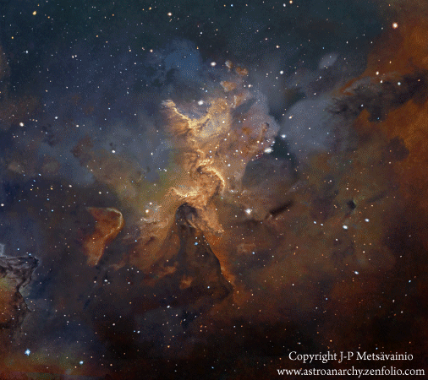
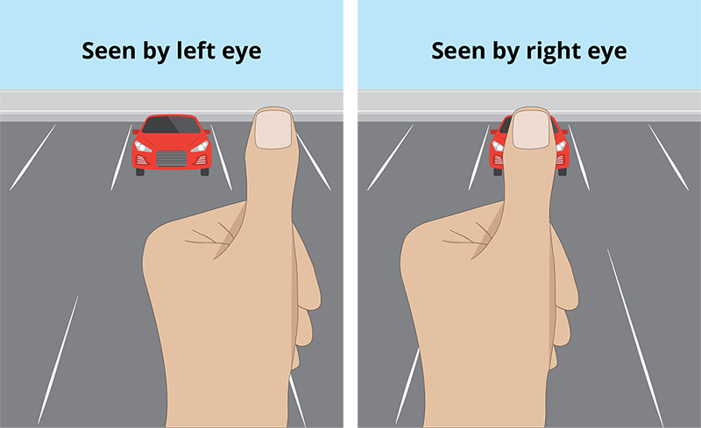
Measuring distance
with Parallax

Slide 15
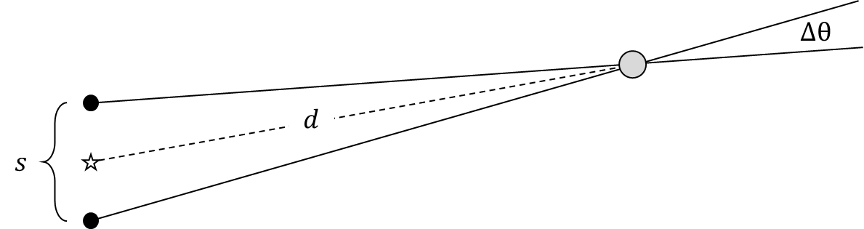
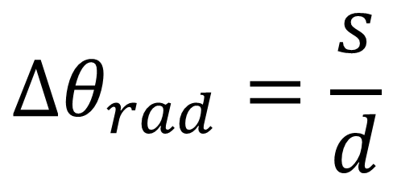
Parallax Angle
$$Δθ_{rad}=\frac{s}{d}$$

Slide 16
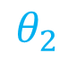
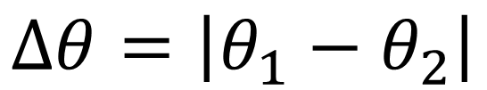

$$Δθ=\left|θ_{1}−θ_{2}\right|$$
$$θ_{1}$$
$$θ_{2}$$

Slide 17
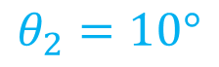
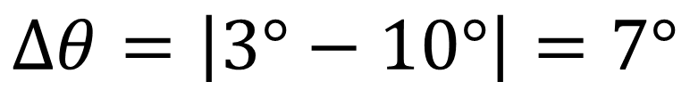
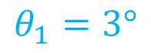
$$Δθ=\left|3°−10°\right|=7°$$
$$θ_{1}=3°$$
$$θ_{2}=10°$$

Slide 18
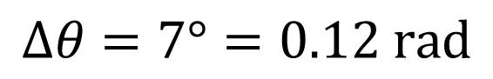
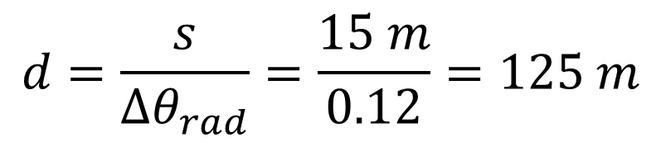


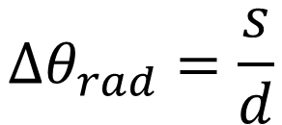
$$Δθ=7°=0.12 rad$$
$$Δθ_{rad}=\frac{s}{d}$$
$$Δθ$$
$$s=15 m$$
$$d=\frac{s}{Δθ_{rad}}=\frac{15 m}{0.12}=125 m$$

